Slide 1
DC and AC Load Line
DC biasing circuits
DC and AC equivalent circuit
Q-point (Static operation point)
DC and AC load line
Saturation Cutoff Condition
Compliance

Slide 2
Book Reference
Electronic Devices and Circuit Theory by Robert Boylestad & Louis Nashelsky ( Prentice Hall )
Electronic Devices by Thomas L. Floyd ( Prentice Hall )

Slide 3
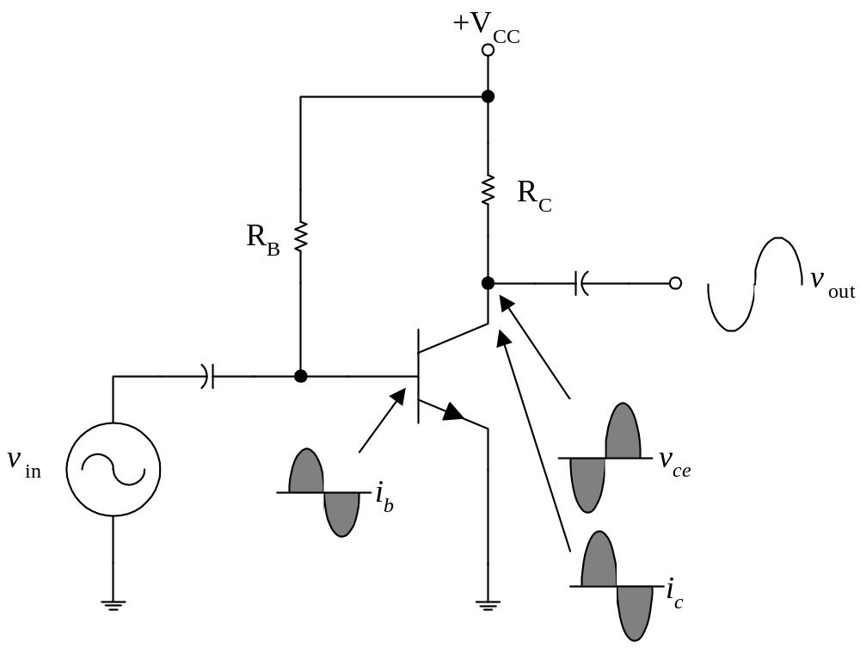
DC Biasing Circuits
The ac operation of an amplifier depends on the initial dc values of I_{B}, I_{C}, and V_{CE}.
By varying I_{B} around an initial dc value, I_{C} and V_{CE} are made to vary around their initial dc values.
DC biasing is a static operation since it deals with setting a fixed (steady) level of current (through the device) with a desired fixed voltage drop across the device.

Slide 4
Purpose of the DC biasing circuit
To turn the device “ON”
To place it in operation in the region of its characteristic where the device operates most linearly, i.e. to set up the initial dc values of I_{B}, I_{C}, and V_{CE}

Slide 5
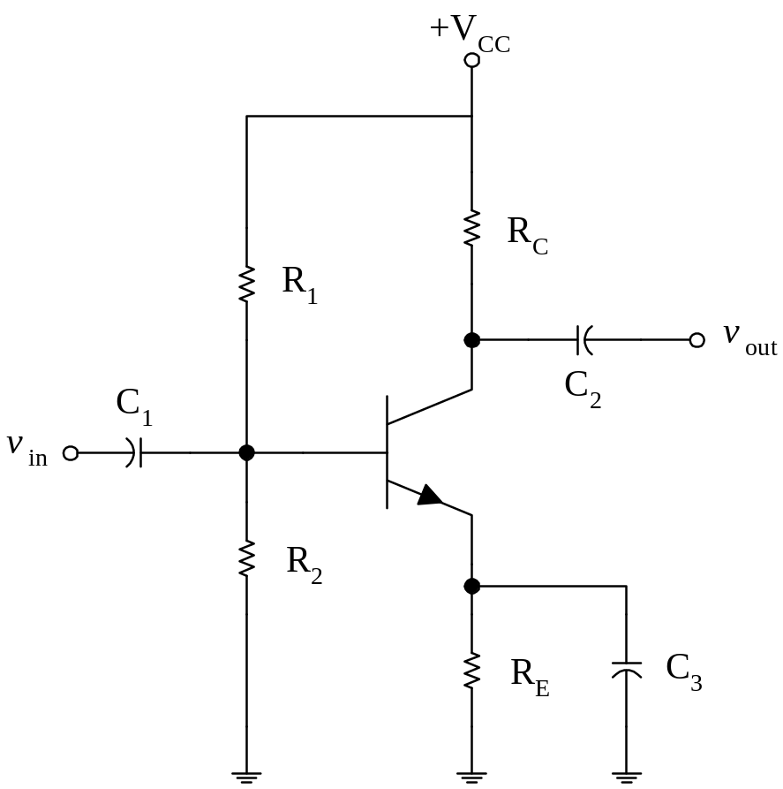
Voltage-Divider Bias
The voltage – divider (or potentiometer) bias circuit is by far the most commonly used.
R_{B1}, R_{B2}
⇒ voltage-divider to set the value of V_{B} , I_{B}
C₃
⇒ to short circuit ac signals to ground, while not effect the DC operating (or biasing) of a circuit
(R_{E} ⇒ stabilizes the ac signals)
→ Bypass Capacitor

Slide 6
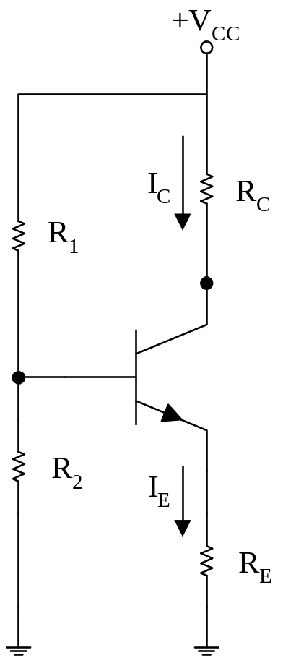
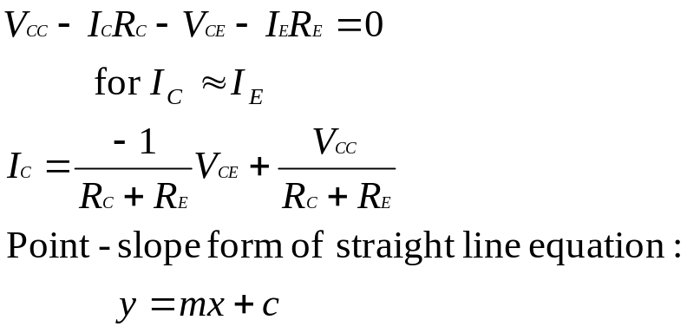
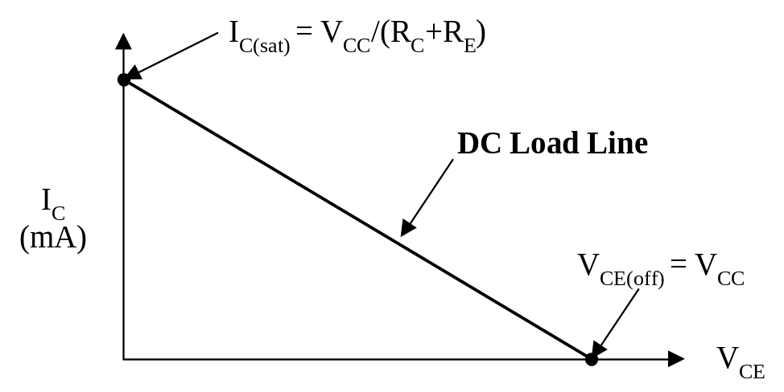
Graphical DC Bias Analysis

Slide 7
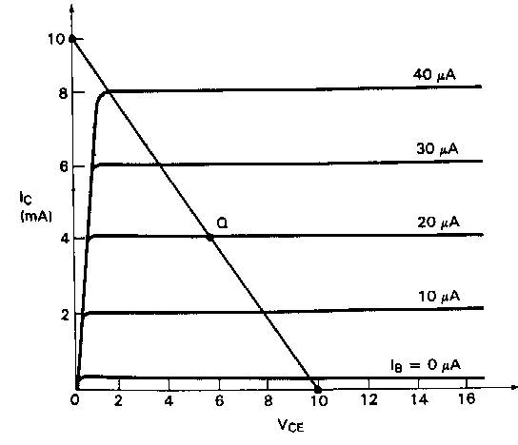
DC Load Line
The straight line is know as the DC load line
Its significance is that regardless of the behavior of the transistor, the collector current I_{C} and the collector-emitter voltage V_{CE} must always lie on the load line, depends ONLY on the V_{CC}, R_{C} and R_{E}
(i.e. The dc load line is a graph that represents all the possible combinations of I_{C} and V_{CE} for a given amplifier. For every possible value of I_{C}, and amplifier will have a corresponding value of V_{CE}.)
It must be true at the same time as the transistor characteristic. Solve two condition using simultaneous equation
→ graphically → Q-point !!
What is I_{C(sat)} and V_{CE(off)} ?

Slide 8
Q-Point (Static Operation Point)
When a transistor does not have an ac input, it will have specific dc values of I_{C} and V_{CE}.
These values correspond to a specific point on the dc load line. This point is called the Q-point.
The letter Q corresponds to the word (Latent) quiescent, meaning at rest.
A quiescent amplifier is one that has no ac signal applied and therefore has constant dc values of I_{C} and V_{CE}.

Slide 9
Q-Point (Static Operation Point)
The intersection of the dc bias value of I_{B} with the dc load line determines the Q-point.
It is desirable to have the Q-point centered on the load line. Why?
When a circuit is designed to have a centered Q-point, the amplifier is said to be midpoint biased.
Midpoint biasing allows optimum ac operation of the amplifier.

Slide 10
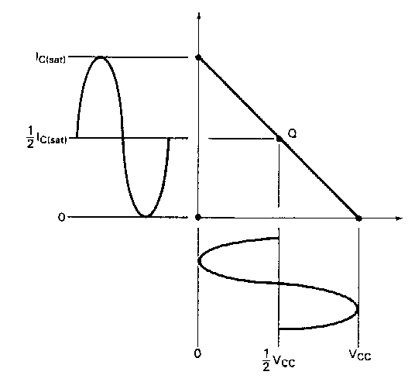
DC Biasing + AC signal
When an ac signal is applied to the base of the transistor, I_{C} and V_{CE} will both vary around their Q-point values.
When the Q-point is centered, I_{C} and V_{CE} can both make the maximum possible transitions above and below their initial dc values.
When the Q-point is above the center on the load line, the input signal may cause the transistor to saturate. When this happens, a part of the output signal will be clipped off.
When the Q-point is below midpoint on the load line, the input signal may cause the transistor to cutoff. This can also cause a portion of the output signal to be clipped.

Slide 11
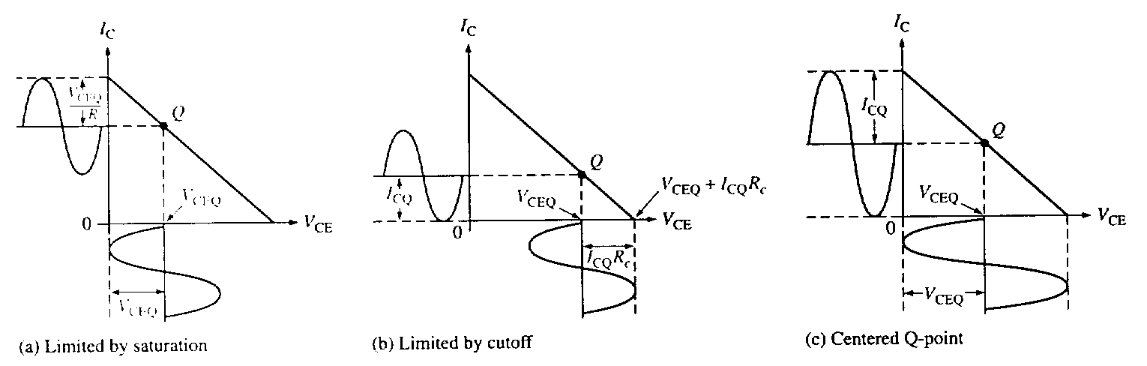
DC Biasing + AC signal

Slide 12
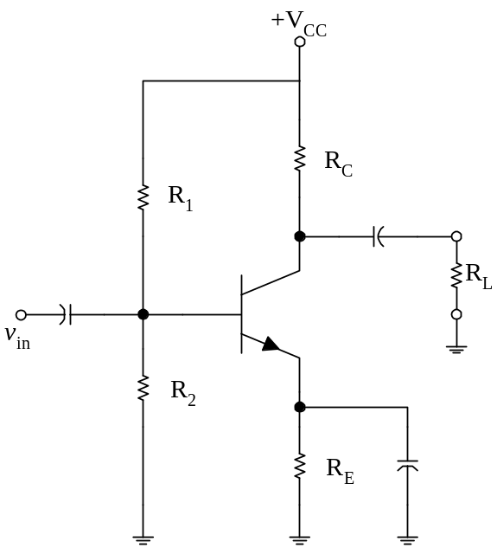
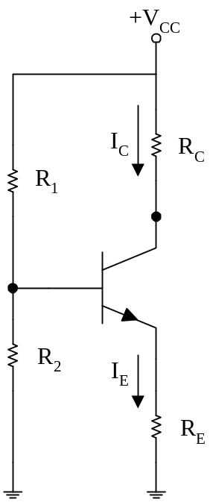
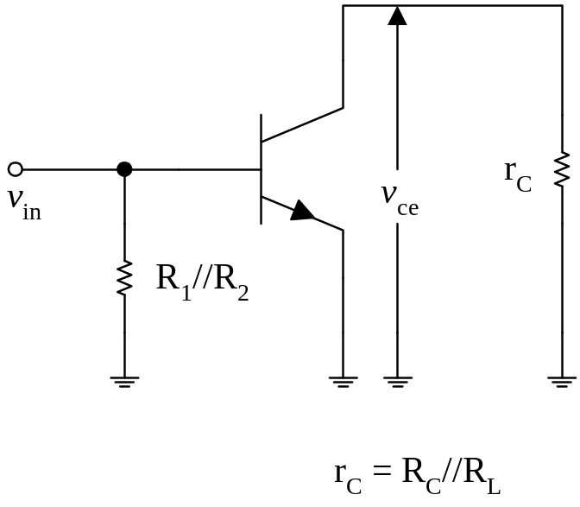
DC and AC Equivalent Circuits
Bias Circuit
DC equivalent circuit
AC equivalent circuit

Slide 13
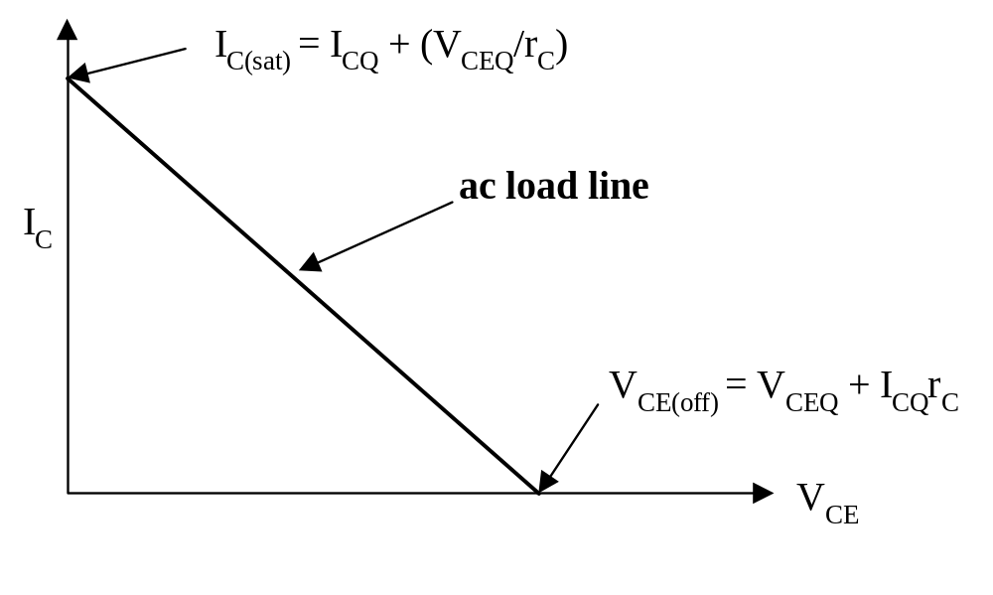
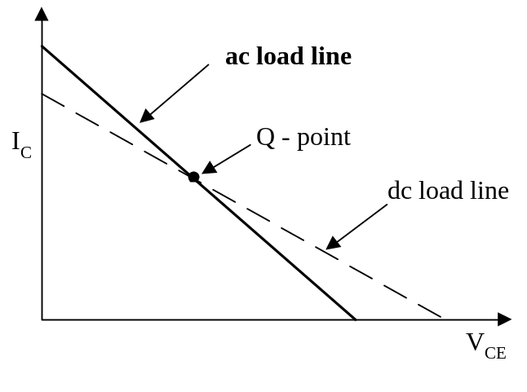
AC Load Line
The ac load line of a given amplifier will not follow the plot of the dc load line.
This is due to the dc load of an amplifier is different from the ac load.

Slide 14
AC Load Line
What does the ac load line tell you?
The ac load line is used to tell you the maximum possible output voltage swing for a given common-emitter amplifier.
In other words, the ac load line will tell you the maximum possible peak-to-peak output voltage (V_{pp} ) from a given amplifier.
This maximum V_{pp} is referred to as the compliance of the amplifier.
(AC Saturation Current I_{c(sat)} , AC Cutoff Voltage V_{CE(off)} )

Slide 15
AC Saturation Current and AC Cutoff Voltage

Slide 16
Amplifier Compliance
The ac load line is used to tell the maximum possible output voltage swing for a given common-emitter amplifier. In another words, the ac load line will tell the maximum possible peak-to-peak output voltage (V_{PP}) from a given amplifier. This maximum V_{PP} is referred to as the compliance of the amplifier.
The compliance of an amplifier is found by determine the maximum possible of I_{C} and V_{CE} from their respective values of I_{CQ} and V_{CEQ}.

Slide 17
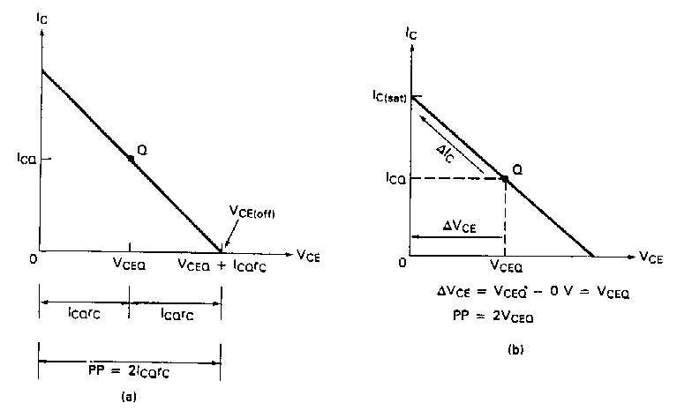
Maximum Possible Compliance

Slide 18
Compliance
The maximum possible transition for V_{CE} is equal to the difference between V_{CE(off)} and V_{CEQ}. Since this transition is equal to I_{CQ}r_{C}, the maximum peak output voltage from the amplifier is equal to I_{CQ}r_{C}. Two times this value will give the maximum peak-to-peak transition of the output voltage:
V_{PP} = the output compliance, in peak-to-peak voltage
I_{CQ} = the quiescent value of I_{C}
r_{C} = the ac load resistance in the circuit
V_{PP} = 2I_{CQ}r_{C}
(A)

Slide 19
Compliance
When I_{C} = I_{C(sat)­}, V_{CE} is ideally equal to 0V. When I­_{C} = I_{CQ}, V_{CE} is at V_{CEQ}. Note that when I_{C} makes its maximum possible transition (from I_{CQ} to I_{C(sat)}), the output voltage changes by an amount equal to V_{CEQ}. Thus the maximum peak-to-peak transition would be equal to twice this value:
Equation (A) sets the limit in terms of V_{CE(off)}. If the value obtained by this equation is exceed, the output voltage will try to exceed V_{CE(off)}, which is not possible. This is called cutoff clipping, because the output voltage is clipped off at the value of V_{CE(off)}.
Equation (B) sets of the limit in terms of I_{C(sat)}. If the value obtained by this equation is exceed, the output will experience saturation clipping.
V_{PP} = 2V_{CEQ}
(B)

Slide 20
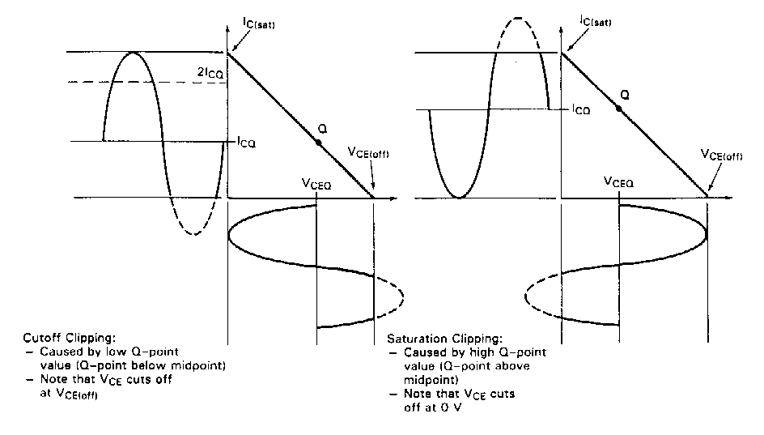
Cutoff and Saturation Clipping
When determining the output compliance for a given amplifier, solve both equation (A) and (B). The lower of the two results is the compliance of the amplifier.

Slide 21
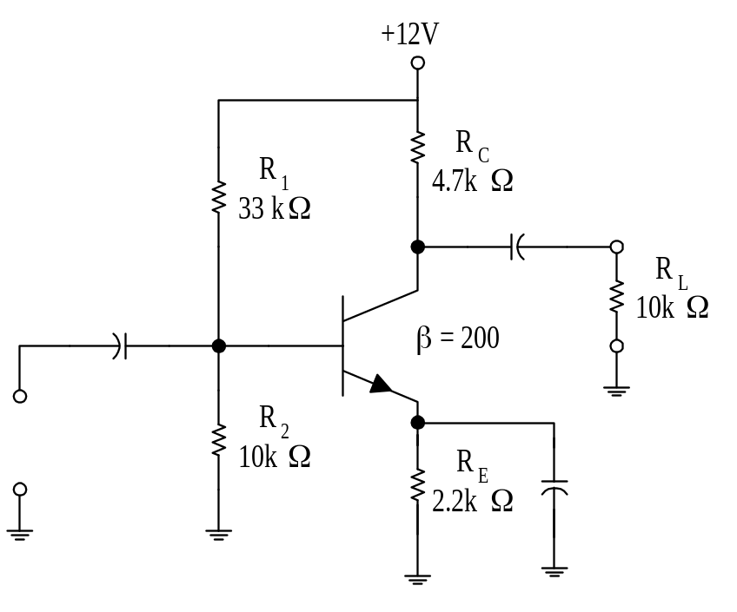
Example
For the voltage-divider bias amplifier shown in the figure, what is the ac and dc load line. Determine the maximum output compliance.

